Slide 1
4-H and Ag Career Pathways in Ventura County
Youth development experiences that connect agriculture education to real-world learning
Presenter:
Melissa Guillen 4-H Youth Development Advisor for San Luis Obispo, Santa Barbara, and Ventura Counties
mpguillen@ucanr.edu
Claudia Carlos 4-H Regional Program Coordinator for Orange, Los Angeles and Ventura Counties
cfcarlos@ucanr.edu
https://ucanr.edu/county/cooperative-extension-ventura-county/ventura-county-4-h

Slide 2

Objectives
Learn about current 4-H Ventura programs and what 4-H offers
See how data and mapping can uncover gaps in youth access
Learn how to use that information to guide programs and partnerships
Walk away with at least one way to apply this in your own work

Slide 3
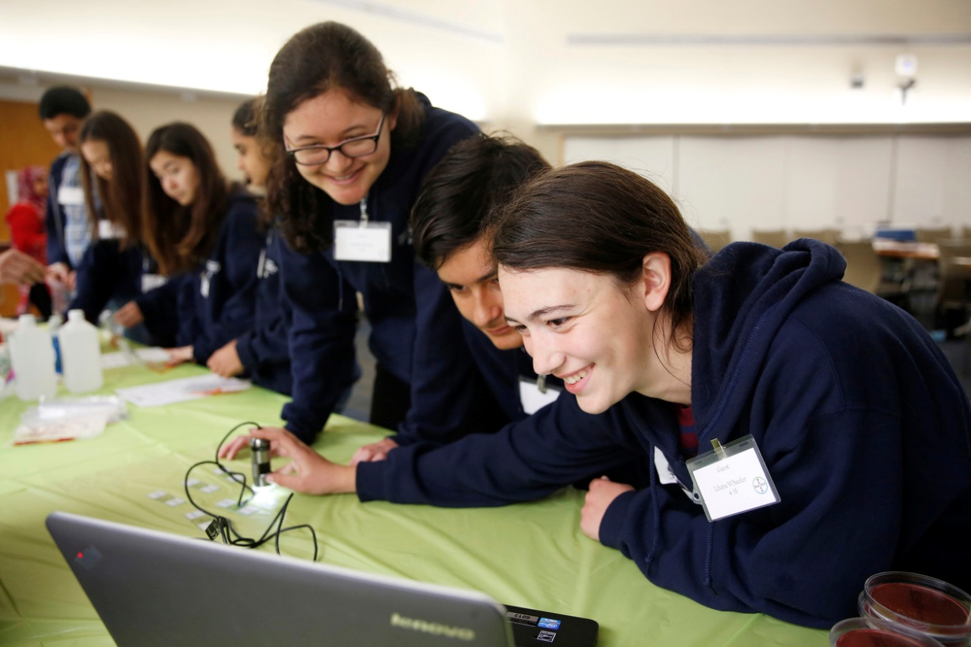
Understanding Youth Opportunity in Ventura County
College and career readiness develops through skills, relationships, and access to opportunities¹⁻⁴
Youth experiences vary depending on where they live and the systems around them¹⁻⁵
Data can help us identify where opportunities already exist and where gaps may remain
4H High school students tour and learn from employees at Bayer (Alison Yin/AP Images for National 4-H Council).

Slide 4
Where 4-H Fits in the Ag Career Pathway
Early Exposure
School gardens
Ag in the classroom
Farm field trips
Applied Learning and Skill Development
Animal science
Gardening and plant science
STEM/STEAM
Natural resource education
Leadership and Communication
Postsecondary Pathways
Community Colleges
CSU Channel Islands
Agriculture and Food System Careers
Farming and ranching
Natural resource management
Food systems
Agricultural technology

Slide 5

What Makes 4-H Different
Hands-on Learning
Raising animals
Gardening
Environmental science
Youth Leadership
Teen teachers
Mentorship
Career Skill Development
Responsibility
Entrepreneurship
Career exploration

Slide 6
Examples of project areas youth explore through 4-H experiential learning
🐖 Animal Science | 🌱 Plant and Food Systems | 💧 Natural Resources and Environmental Science | ⭐ Leadership and Skill Development
Swine Sheep Goats Poultry Rabbits Beef / Dairy Horses | Gardening Plant science Food Production Food Preservation | Water and watershed education Soil science Forestry Environmental stewardship Beekeeping | Public speaking Community service Teen leaders / mentoring Entrepreneurship
Delivery modes:
Clubs Short-term/Project-based • In-school • After-school • Camps • Military • Special Interest Programs/Clubs

Slide 7
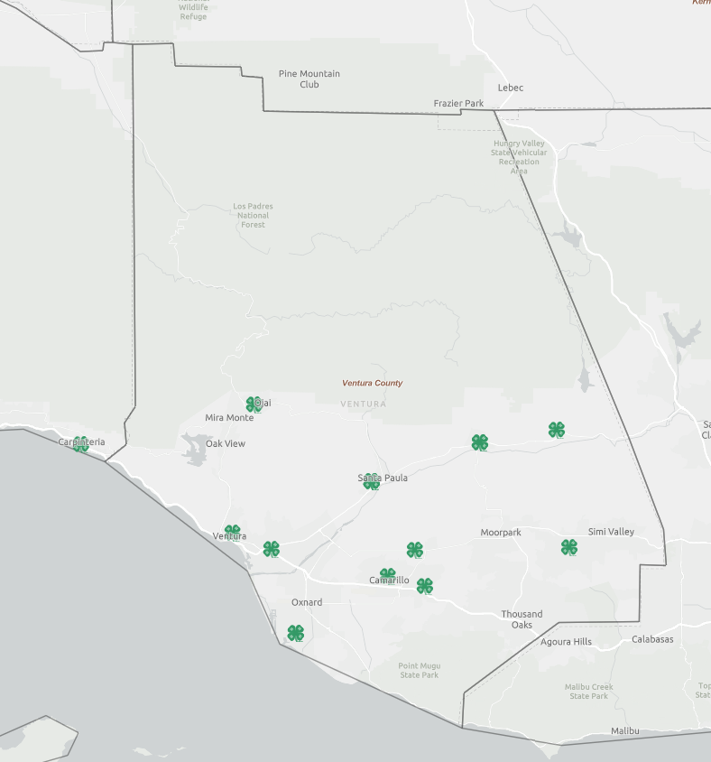
Current 4-H Reach in Ventura County
Average annual participation since 2022
440 youth
91 volunteers
Programs primarily delivered through community clubs
Ventura County has strong volunteer-led programs, but most youth in the county are not currently connected to 4-H opportunities.
Notes:
https://www.arcgis.com/apps/dashboards/1d6d1de416d640fba09d566728232108

Slide 8
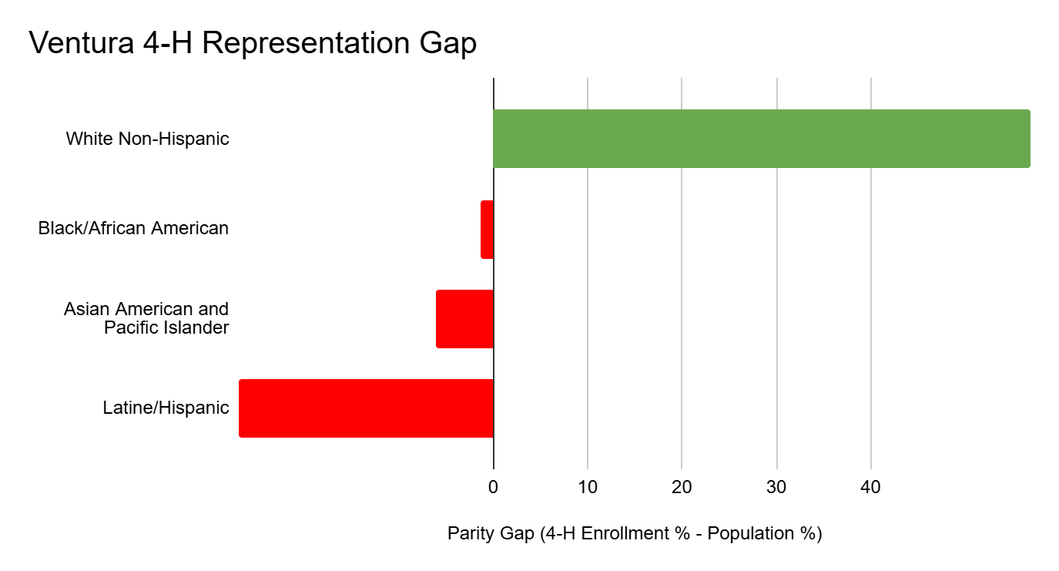
Program Parity
Parity gap = difference between youth population demographics and program participation
Notes:
https://www.arcgis.com/apps/dashboards/1d6d1de416d640fba09d566728232108

Slide 9
What do we do with this?
Target outreach in underrepresented communities
Partner with organizations already serving these youth
Adapt program delivery (location, language, format)
Track changes over time
Notes:
https://www.arcgis.com/apps/dashboards/1d6d1de416d640fba09d566728232108

Slide 10
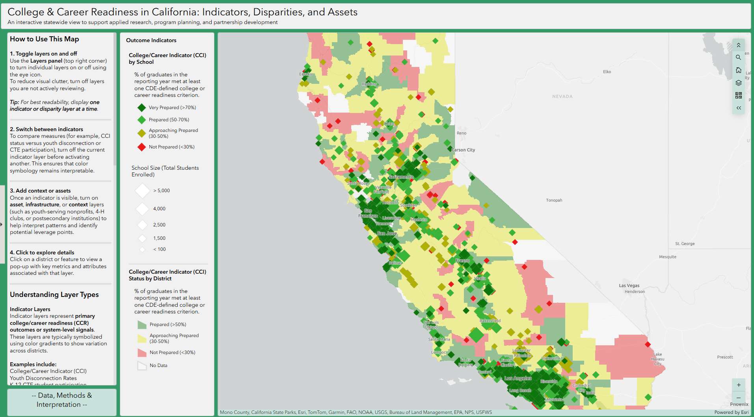
Why Spatial Mapping?
Maps help us see patterns that spreadsheets cannot.
Spatial analysis allows us to:
Show inequities visually (not just describe them)
Communicate quickly with decision-makers
Strengthen grant proposals with clear need
Justify where to invest time and resources⁸

Slide 11
How this could apply to your work
This does not require a full GIS system
Spatial analysis can allow you to:
Identify where your clients are not being reached
Make stronger cases for funding and resources
Prioritize partnerships based on need, not guesswork
Align programs with workforce and community realities

Slide 12
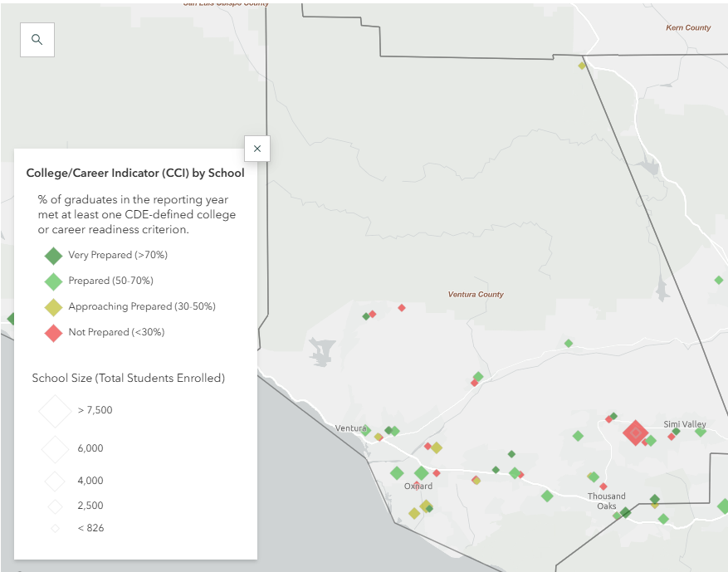
College/Career Indicator
Link to StoryMap
4-H Teen Leaders (Evett Kilmartin)

Slide 13
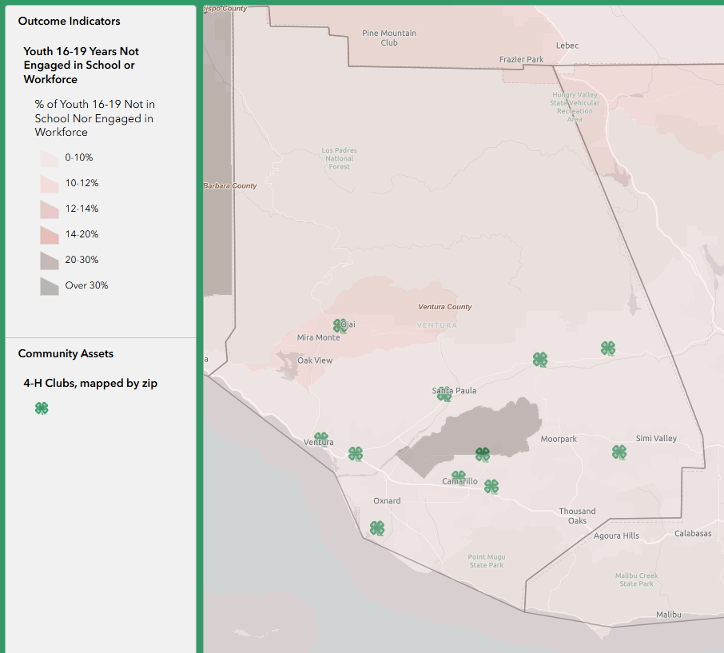
Youth Disconnection

Slide 14
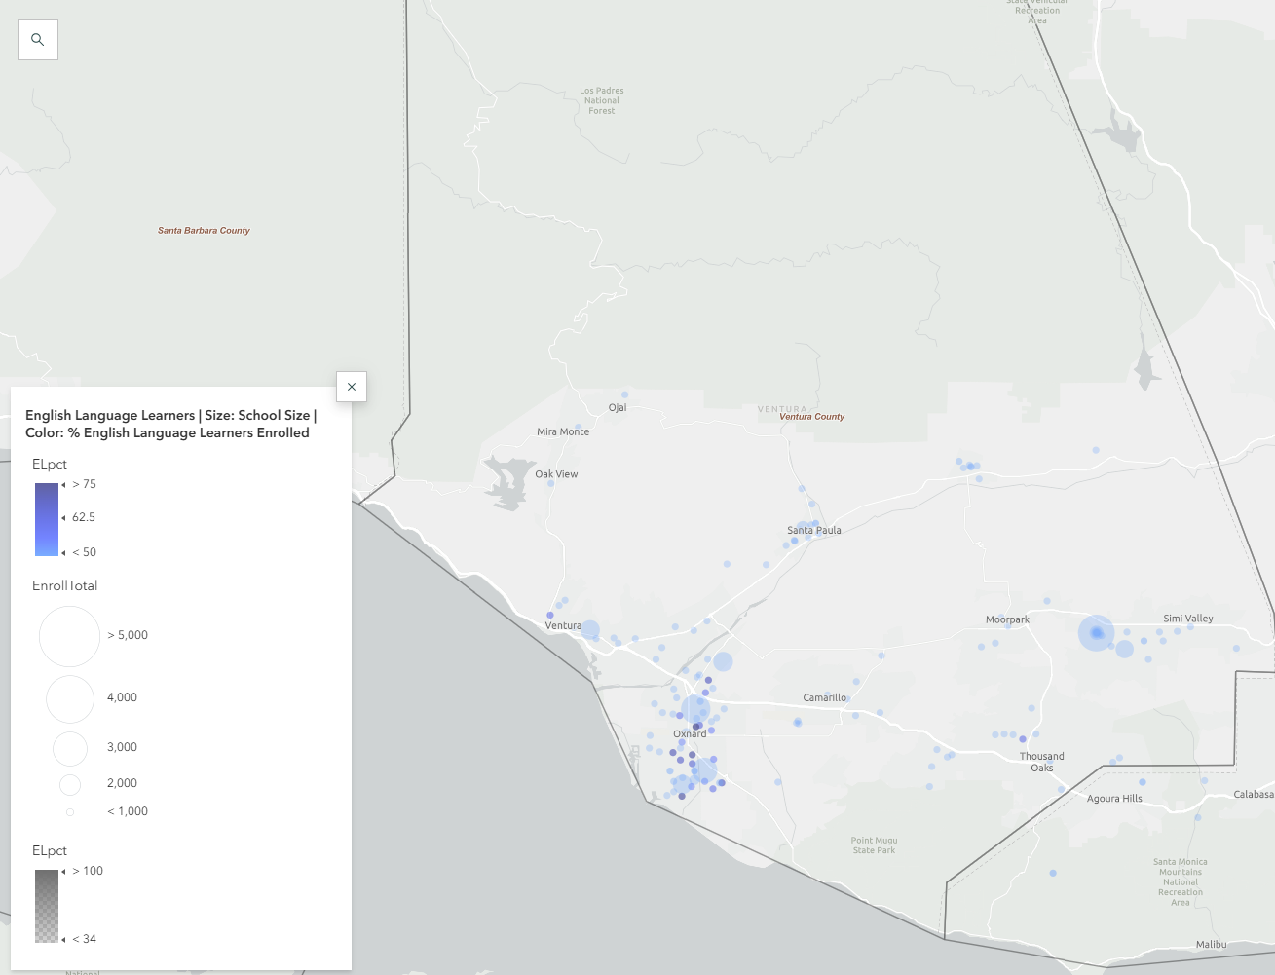
English Language Learners
4-H Teen Leaders (Evett Kilmartin)

Slide 15
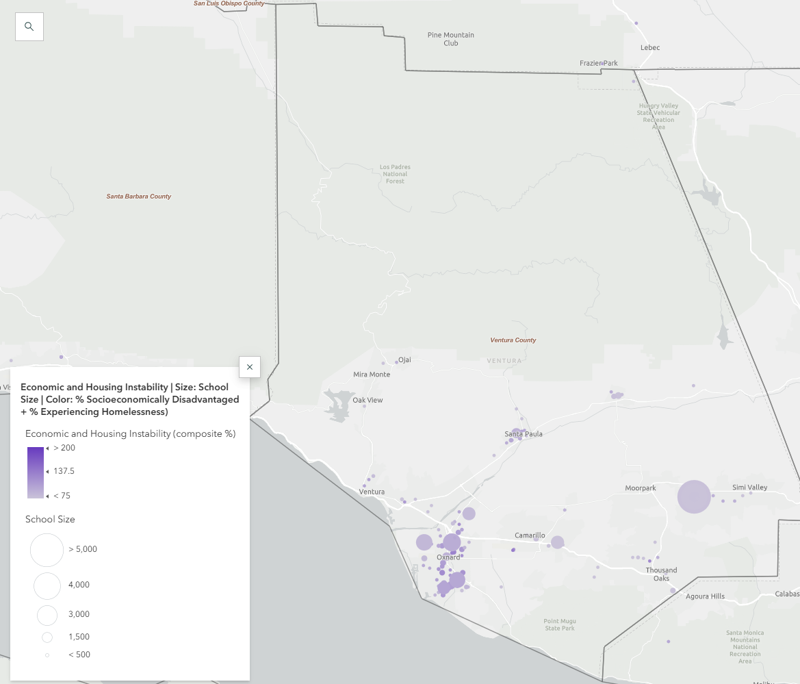
Structural barriers
4-H Teen Leaders (Evett Kilmartin)

Slide 16

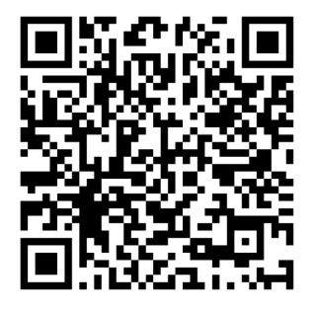
Interactive Map Activity
Small groups
Explore the map digitally or use printouts
Share Observations
One gap you identified
One potential partner
One idea for action
Alternate QR to use if file is too large:

Slide 17
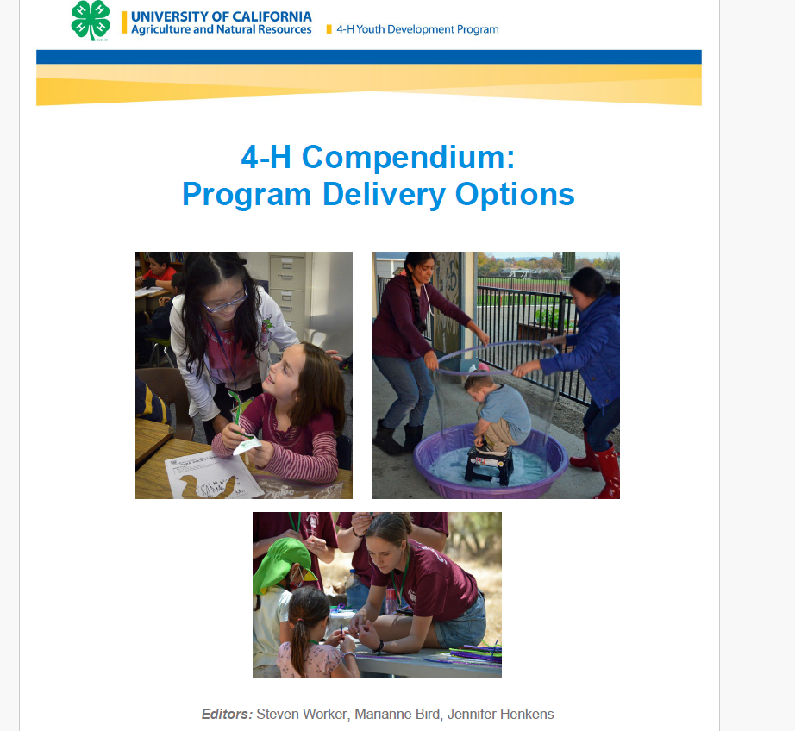
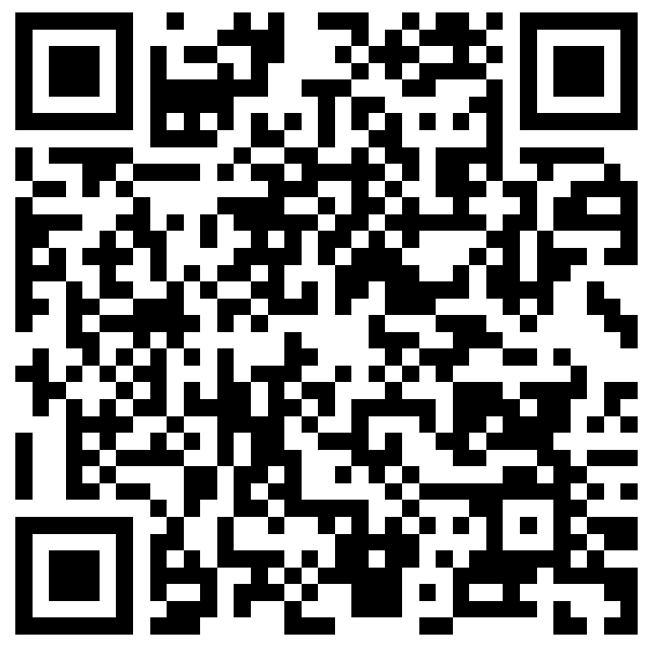
4-H’s Partnership Approach
• Use data to understand context, not evaluate schools
• Focus on barriers students face
• Co-design programming with local partners
• Expand access to opportunities through collaborative programming
View our programs and
curricula here:
Worker et al. (2022)

Slide 18

A Structural Gap
• Ventura 4-H is seeking a long-term livestock space
• Youth need a location to house animals for projects
• Livestock experiences are often the entry point into agriculture careers

Slide 19
Opportunity for Collaboration
Possible partners:
Schools in high-need areas
Community colleges with ag pathways
Farms located near underserved populations
Organizations already serving target youth
Idea: Shared agricultural learning space
Youth livestock projects
Field trips
Demonstrations
Career exploration
Internships

Slide 20

What you can do next
Identify one gap in your community
Look at one data source (school, census, etc.)
Map or visualize your current programs
Reach out to one potential partner
Start small and build
Photo: Kilmartin, Evett

Slide 21
How to Use Mapped Data
Use publicly available data:
School demographics (CDE)
Census / KidsData
Overlay with:
Your program locations
Partner organizations
Maps you can use now:
https://www.policymap.com/
Link to StoryMap
Public School Enrollment Patterns for Parity Planning- 4-H CA Statewide
College and Career Readiness CA
Notes:
https://www.arcgis.com/apps/dashboards/1d6d1de416d640fba09d566728232108

Slide 22
Resources
Atwell, M. (2024). Portraits of a graduate: Strengthening career and college readiness through social and emotional skill development. Collaborative for Academic, Social, and Emotional Learning.
Green, S., Sanczyk, A., Chambers, C., Mraz, M., & Polly, D. (2023). College and career readiness: A literature synthesis. Journal of Education, 203(1), 222–229. https://doi.org/10.1177/00220574211002209
Marcinak, J., Johnston, C. S., Steiner, R. S., & Hirschi, A. (2022). Career preparedness among adolescents: A review of key components and directions for future research. Journal of Career Development, 49(1), 18–40. https://doi.org/10.1177/0894845320934951
U.S. Chamber of Commerce Foundation, & College Board. (2025). Bridging the readiness gap: Aligning education and workforce systems. https://www.uschamberfoundation.org
Heller, D. E., Backes, B., & Holzer, H. J. (2017). Improving access to postsecondary education: A review of evidence on college navigation and advising. Brookings Institution. https://www.brookings.edu
Arnold, M. E. (2018). From Context to Outcomes: A Thriving Model for 4-H Youth Development Programs. Journal of Human Sciences and Extension, 6(1), 11. DOI: https://doi.org/10.54718/NBNL5438
Lerner, R. M., Lerner, J. V., & Benson, J. B. (2011). Positive Youth Development: Research and Applications for Promoting Thriving in Adolescence. Advances in Child Development and Behavior, 41, 1-17.
Vyas, A., & Aguilera, A. (2025). Geographic information systems in community research and planning: Methods and applications. Journal of Community Informatics.
Gándara, Patricia. 2015. The Implications of Deeper Learning for Adolescent Immigrants and English Language Learners. Students at the Center: Deeper Learning Research Series. Boston, MA: Jobs for the Future.
Kanno, Y. (2021). English learners’ access to and enrollment in college preparatory courses: Implications for college readiness. Educational Policy, 35(5), 789–816.
Johnson, A., & Mercado-Garcia, D. (2022). The effects of early college opportunities on English learners. American Educational Research Journal, 59(4), 719–751. https://doi.org/10.3102/00028312221075068
Hughes, B.S., Corrigan, M.W., Grove, D. et al. Integrating arts with STEM and leading with STEAM to increase science learning with equity for emerging bilingual learners in the United States. IJ STEM Ed 9, 58 (2022). https://doi.org/10.1186/s40594-022-00375-7

